Slide 1
EDA Medical Appointment System - Visuals Developed in Python

Slide 2
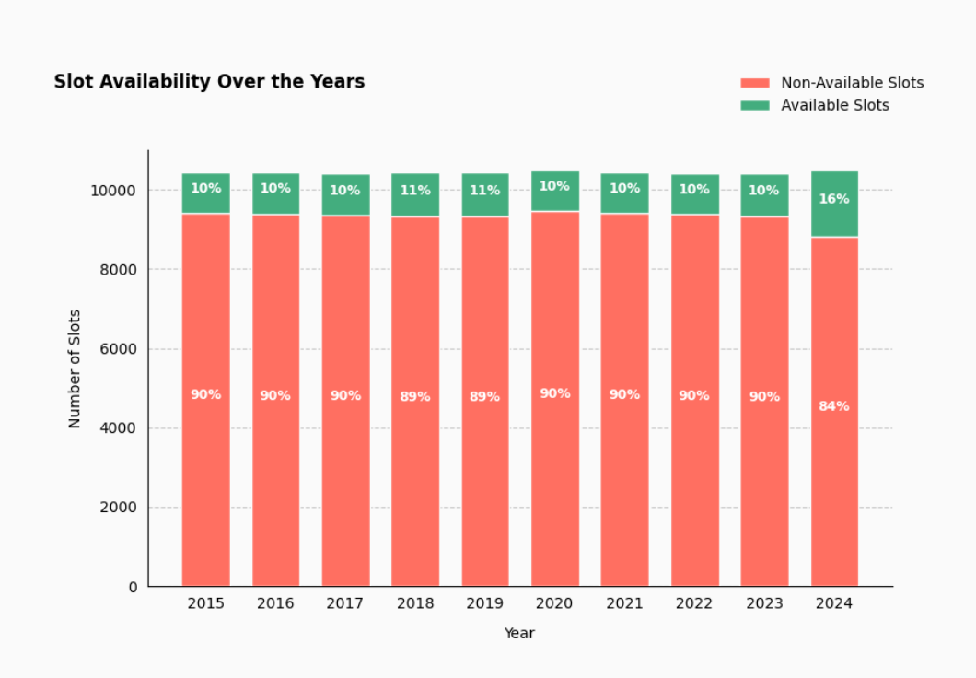
Slot Availability over the years
Slot availability remained consistent at 10-11% from 2015 to 2023, with a notable increase to 16% in 2024, indicating improved resource management or accessibility.

Slide 3
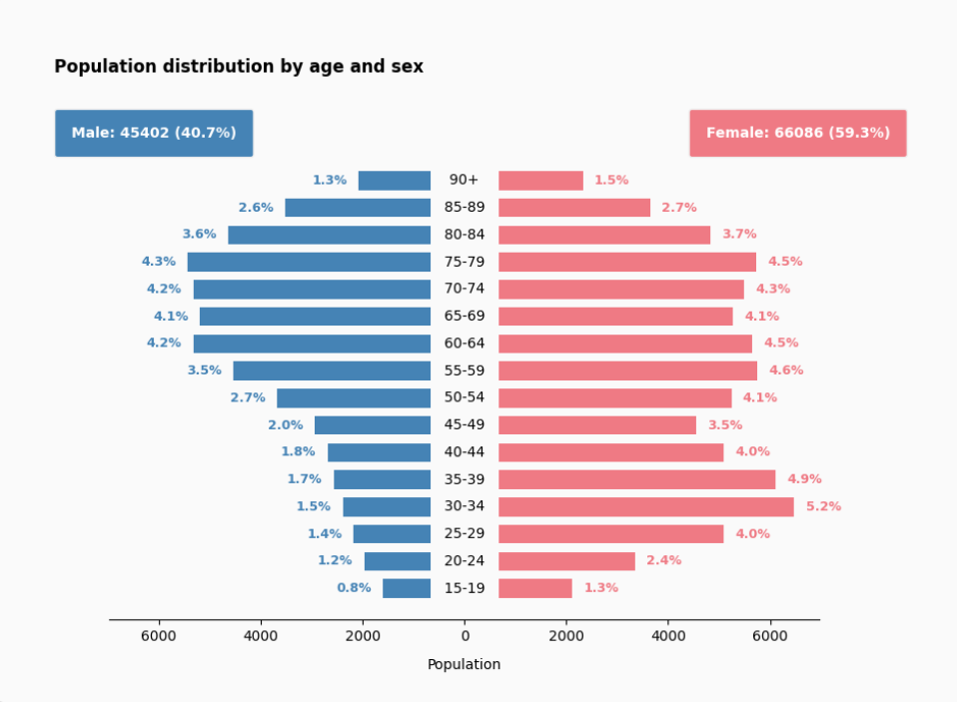
Population Distribution by age and sex
The population is predominantly female (59.3%), with females having higher representation in almost all age groups, particularly in older demographics (65+), while males account for 40.7% of the population, showing relatively lower proportions across all age brackets.

Slide 4
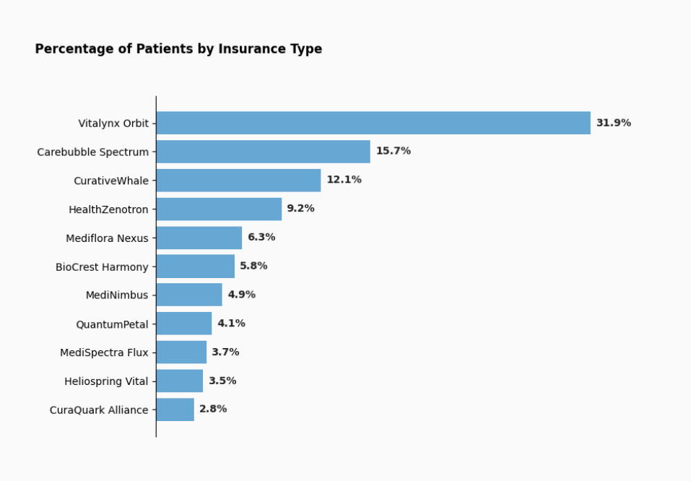
Percentage of Patients by Insurance Type
Vitalynx Orbit dominates with 31.9% of patients, followed by Carebubble Spectrum (15.7%) and CurativeWhale (12.1%), while CuraQuark Alliance has the smallest share at 2.8%, indicating significant disparities in patient distribution across insurance types.

Slide 5
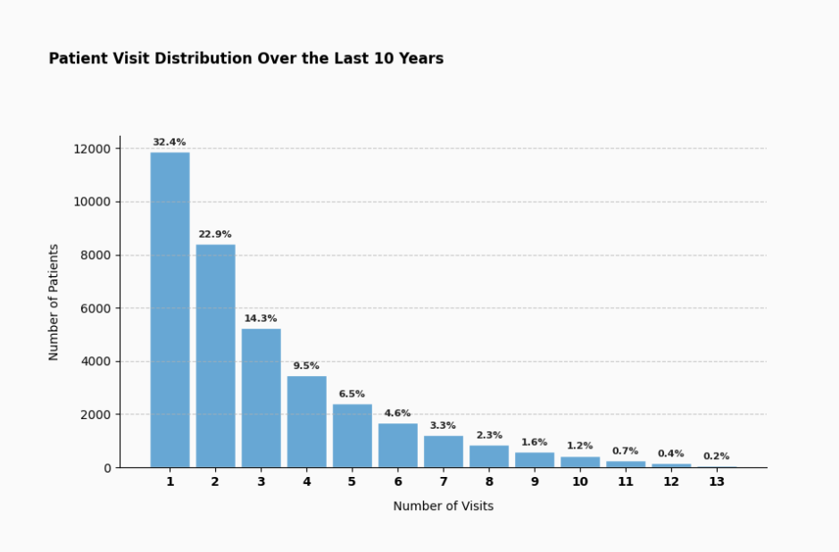
Patient Visit Distribution Over the Last 10 years
The majority of patients (32.4%) visited only once in the last 10 years, with a sharp decline in repeat visits as the number of visits increases, indicating a highly skewed distribution toward infrequent visits.

Slide 6
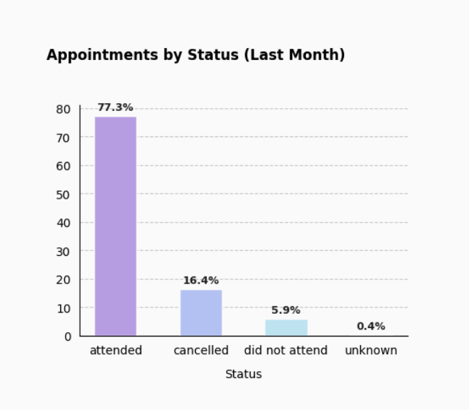
Appointments by Status
The majority of appointments last month (77.3%) were attended, 16.4% were canceled, 5.9% were marked as "did not attend," and only 0.4% had an unknown status, indicating a high attendance rate with minimal no-shows or ambiguity.

Slide 7
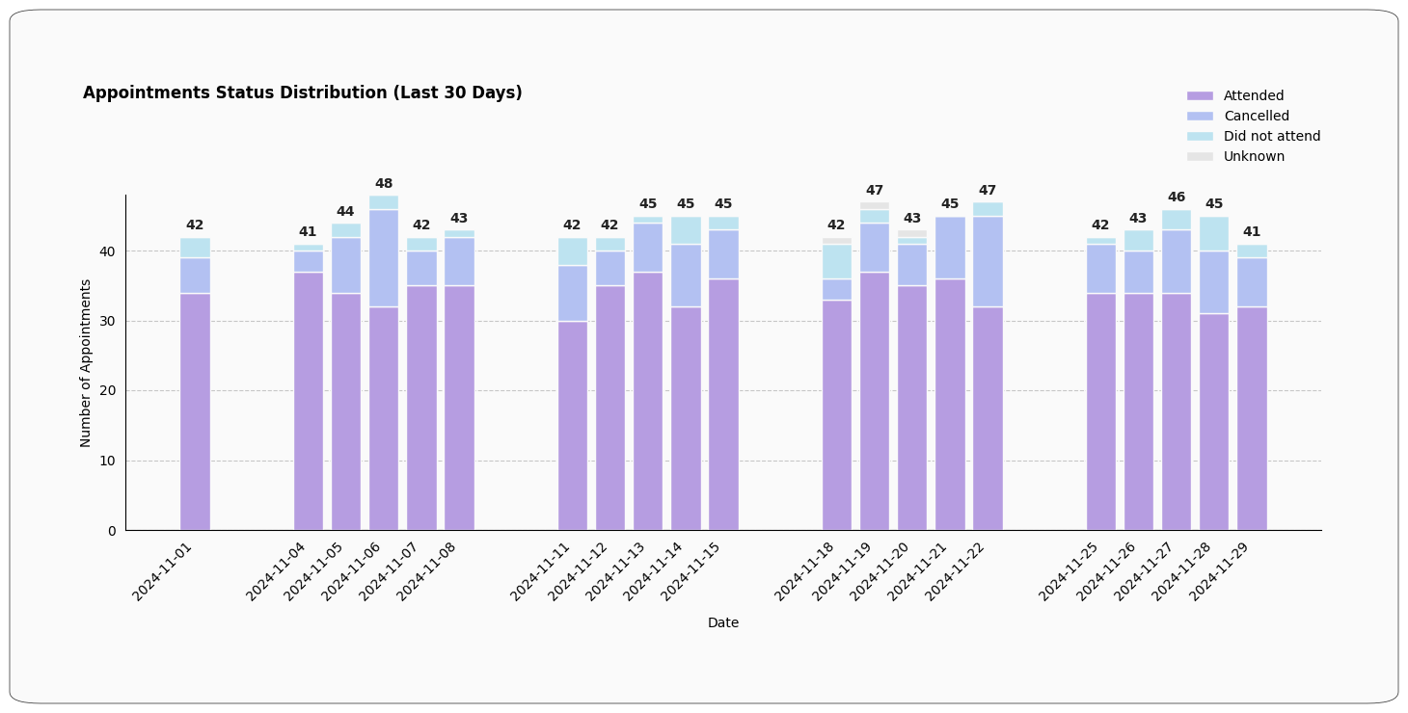
Appointments Status Distribution
Over the last 30 days, the majority of appointments were attended (indicated by the dominant purple bars), while cancellations and no-shows occurred at consistent, smaller proportions, reflecting a high rate of patient engagement with minimal fluctuation across the period.

Slide 8
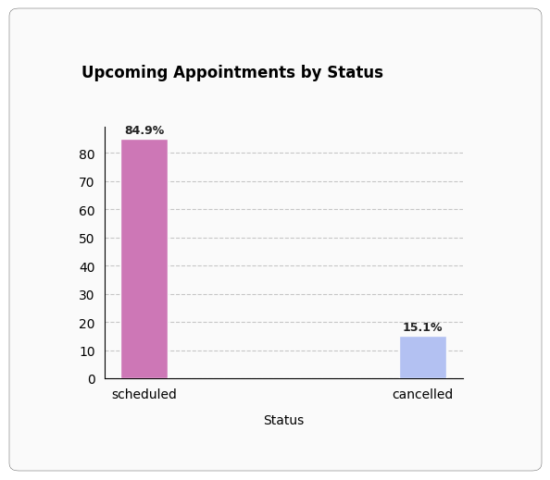
Upcoming Appointments by status
The majority of upcoming appointments (84.9%) are scheduled, while 15.1% have been canceled, indicating a strong commitment to appointments with a relatively low cancellation rate.

Slide 9
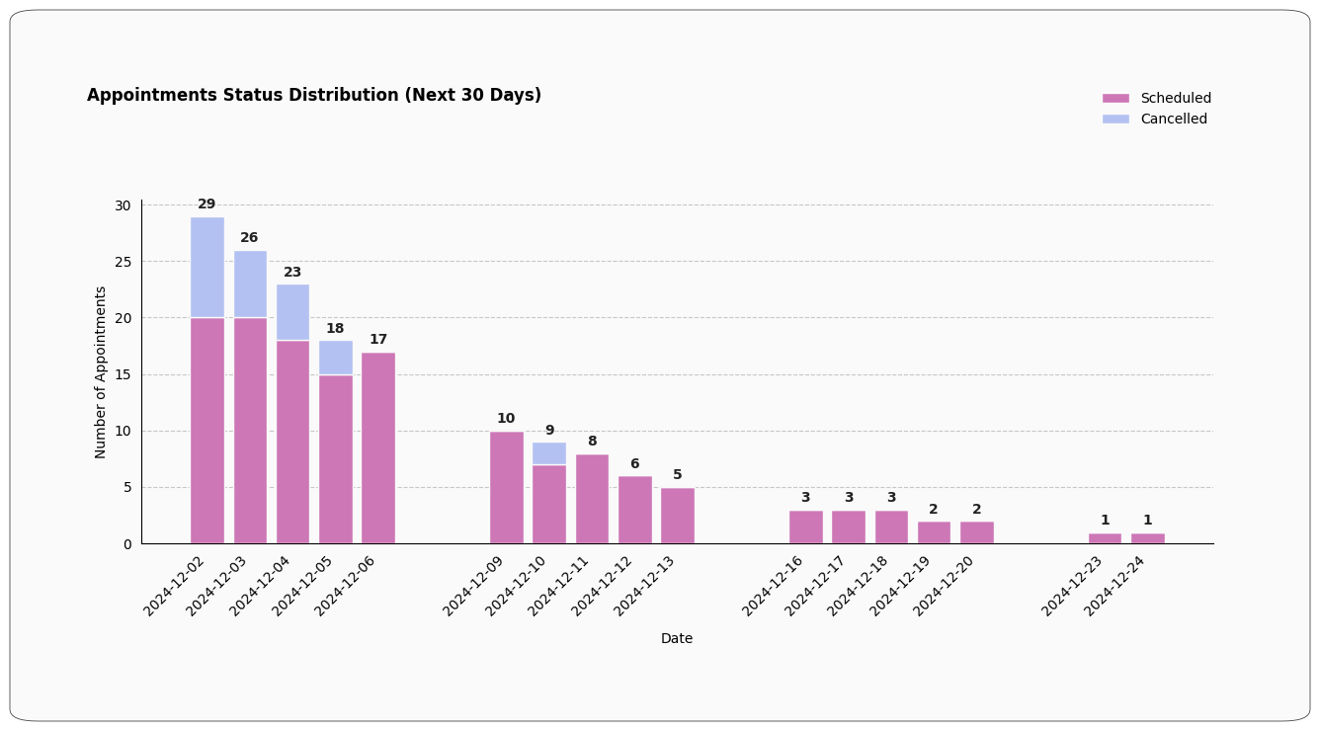
Appointments Status Distribution
In the next 30 days, the number of scheduled appointments is highest in the first week of December, gradually decreasing over time, with cancellations primarily occurring early in the month and minimal activity seen in the latter half, indicating a tapering off of both scheduled and canceled appointments as the month progresses.

Slide 10
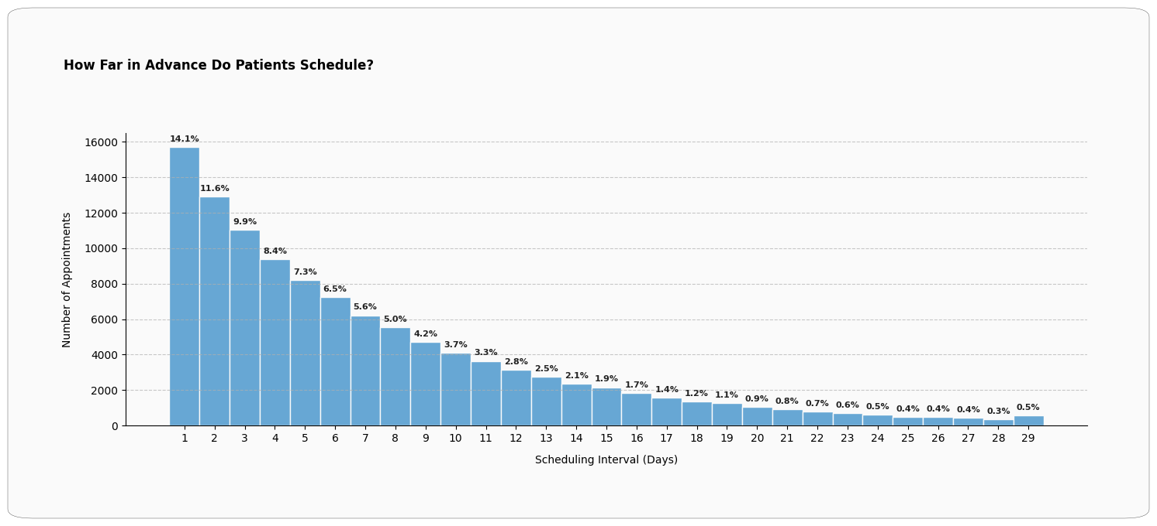
How Far in Advance Do patients Schedule?
The majority of patients schedule appointments within 1 to 5 days in advance, with 14.1% scheduling on the first day itself, followed by a gradual decline in scheduling frequency as the interval increases, indicating a preference for short-term planning.

Slide 11
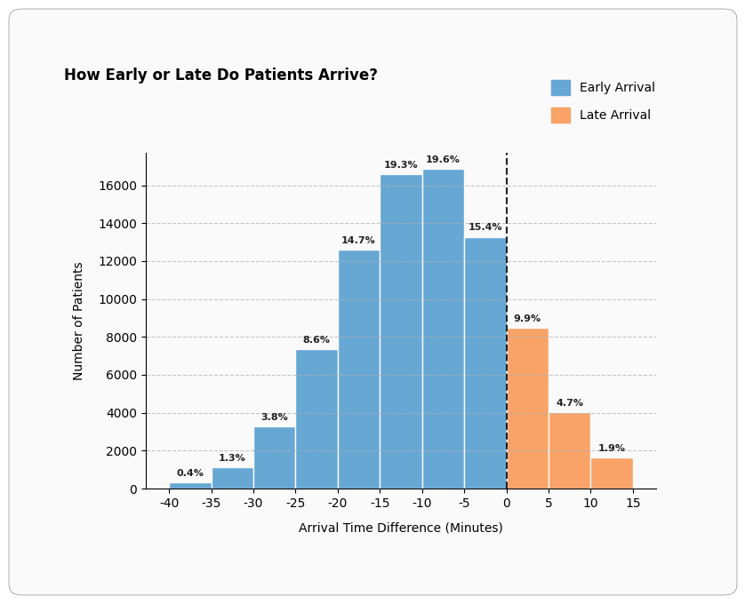
How Early or Late Do Patients Arrive?
Most patients arrive early for their appointments, with a peak of 19.6% arriving 10 minutes early, while late arrivals are less frequent, peaking at 9.9% for those arriving 5 minutes late, indicating a strong tendency for punctuality or early arrival.

Slide 12
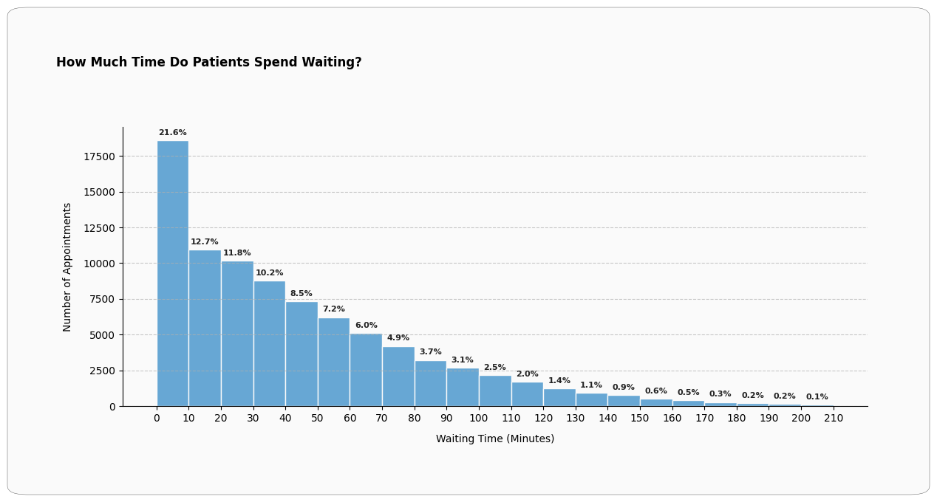
How Much Time Do Patients Spend Waiting?
Most patients spend less than 20 minutes waiting, with 21.6% waiting under 10 minutes, and waiting times gradually decrease beyond 30 minutes, indicating a strong effort to minimize patient wait times, with prolonged waits being relatively rare.

Slide 13
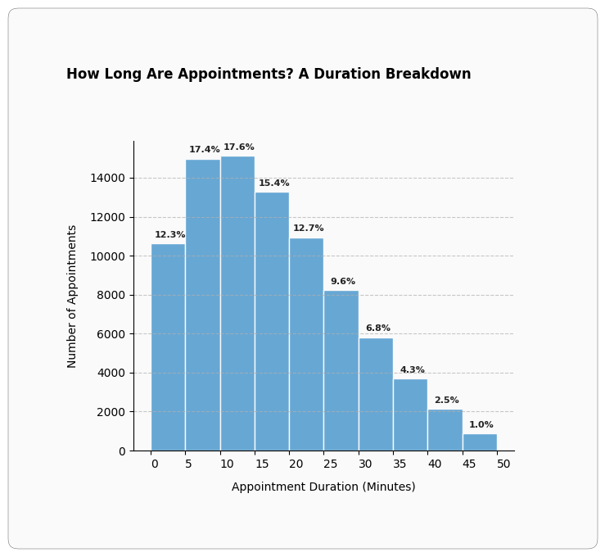
How Long Are Appoinments?
Most appointments are short, with 17.6% lasting 10-15 minutes, followed closely by 17.4% at 5-10 minutes, and durations gradually decreasing as the length increases, indicating a preference for efficient and concise appointment scheduling.

